Slide 1
DASAR SISTEM INFORMASI
Pertemuan 3
Dosen Pengampu : Kartini dan Kundang
Fakultas Ilmu Komputer

Slide 2
What is an component Information System?
Sebuah kombinasi yang terorganisasi
People
Hardware
Software
Communications networks
Data resources
Policies and procedures
That stores, retrieves, update, transforms/mengubah, and disseminates/menyebarkan information in an organization
Notes:
This is a simple definition that we will expand upon later
What’s an example?
Smoke signals to transmit information
Card catalogs in a library
Book bag with day planner, notebooks, that allows you organize inputs from lectures, presentations and discussions. The output is homework and good exam grades
Cash register at restaurant
Other examples?

Slide 3
Information System (IS) versus Information Technology (IT)
IS adalah semua komponen dan sumber daya yang diperlukan untuk memberikan informasi dan fungsi untuk organisasi
TI adalah perangkat keras, perangkat lunak, jaringan dan manajemen data
In theory, IS could be paper based (Secara teori, IS dapat berbasis kertas)
But we will focus on Computer-Based Information Systems (CBIS)
Notes:
Definition of IS from prior slide:
An organized combination of
People
Hardware
Software
Communications networks
Data resources
Policies and procedures
That stores, retrieves, transforms, and disseminates information in an organization
In theory, an IS could be pencil and paper based

Slide 4
Sifat Sistem Informasi
Tidak harus kompleks
Bisa saja menggunakan sebuah komputer

Slide 5
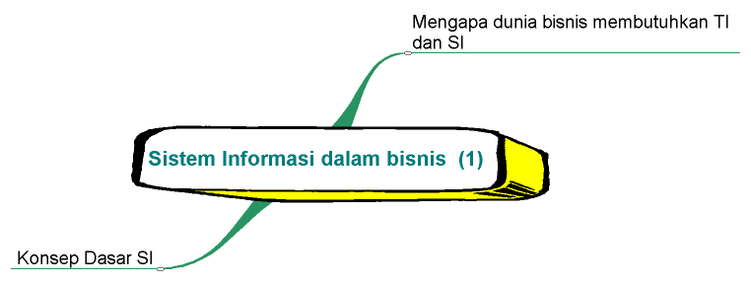
Mind Map
Bagaimana perusahaan menggunakan SI

Slide 6
Pentingnya sistem informasi bagi organisasi
Untuk
menciptakan perusahaan
yang berhasil dan kompetitif,
mengelola perusahaan
secara global, menambah nilai
bisnis dan menyediakan
produk dan jasa yang
bermanfaat bagi
pelanggan.

Slide 7
Pertanyaan Utama bagi Manajer?
Bagaimana mengoptimalkan
return perusahaan dari investasi
sistem informasi

Slide 8
Why Information Systems?
Manajemen Modal: TI telah menjadi komponen investasi modal terbesar bagi perusahaan di AS dan banyak masyarakat industri lainnya.
Pondasi dalam melakukan kegiatan bisnis: Terdapat ketergantungan antara kemampuan perusahaan untuk menggunakan TI dengan kemampuan untuk mengimplementasikan strategi perusahaan dan mencapai tujuan perusahaan. (Lihat gambar 1)
Produktivitas: TI adalah salah satu alat yang paling penting dalam inovasi organisasi untuk menambah produktivitas perusahaan.
Peluang dan Manfaat Strategik: Investasi dalam TI diperlukan untuk memperoleh peluang baru di pasar, mengembangkan produk baru dan menciptakan jasa baru.

Slide 9
Gambar 1. Ketergantungan antara Organisasi dan SI
Hardware
Strategi Bisnis
Aturan
Proses
Software
Database
Ketergantungan
Telekomu-
nikasi
Organisasi
Sistem Informasi

Slide 10
5 Faktor yang Dipertimbangkan dalam Menilai Dampak TI pada Perusahaan Bisnis
Pertumbuhan Internet dan Bertemunya Teknologi
Transformasi business enterprise
Pertumbuhan Ekonimi yang terhubung secara global
Pertumbuhan Ekonomi Berbasis Ilmu dan Informasi
Munculnya Perusahaan Digital

Slide 11
Perusahaan Digital/Digital Firm
Perusahaan digital adalah perusahaan yang semua hubungan bisnis yang signifikan seperti pelanggan, pemasok dan tenaga kerja dapat dimediasi dan dihubungkan secara digital.
Proses bisnis inti (core business process)diselesaikan melalui jaringan digital menjangkau seluruh organisasi atau menghubungkan sejumlah organisasi.

Slide 12
Sistem Informasi lebih luas daripada komputer
Organisasi
Manajemen
Sistem
Informasi
Teknologi

Slide 13
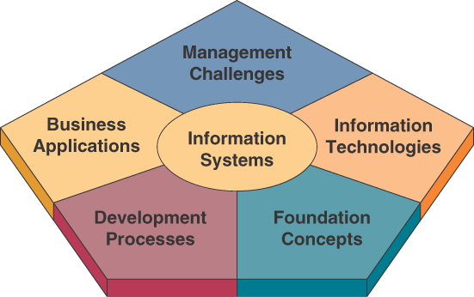
IS Knowledge Framework for Business Professionals

Slide 14
What should a Business Professional know about IS? (Apa yg harus diketahui tentang Bisnis Profesional IS)
Foundation Concepts : perilaku serta , technical, business and managerial concepts (konsep teknis, bisnis dan manajerial)
Information Technology: Hardware, software, networks, data management and Internet-based technology
Business Applications: penggunaan utama (Major uses) of the IS in the organization
Development Processes: How to plan (Bagaimana merencanakan), develop and implement IS to meet(memenuhi) business opportunities
Management Challenges: The challenges/tantangan of effectively and ethically managing/mengelola IT
Notes:
Refers back to figure 1.2 on prior slide
Foundation Concepts: Examples: general systems theory, competitive strategies. Covered in chapters 1, 2
Information Technology: Covered in chapters 3-6
Business Applications: Chapter 7: applications in functional areas, Chapter 8: electronic commerce applications and Chapter 9: decision making
Development Processes: By both business professionals and IS specialists. Chapter 10.
Management Challenges: Managing IT at the end user, enterprise and global levels of a business. Chapter 11 is security challenges and Chapter 12 is how to manage IT in global businesses.

Slide 15
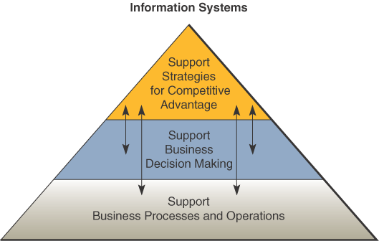
What does IS do for a business? (Apa IS lakukan untuk bisnis?)
Notes:
Examples of business processes: record purchases, track inventory, pay employees, etc. Business would stop without such IS.
Examples of decision making: what lines of merchandise need to be added, what kind of investment required.
Examples of competitive advantage: put kiosk in store to connect to e-commerce website. Help gain advantage over competitor without such a kiosk.

Slide 16
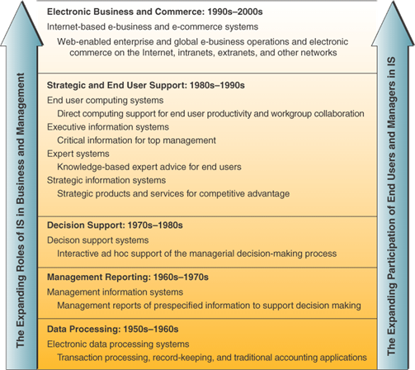
Business Applications expanding role/peran over time /dari wkt ke wkt
Notes:
Note that while IS has expanded, they are still doing the same basic things that they’ve been doing.
What has changed is: more integration of functions, greater connectivity across components, better use for maximum advantage of business and strategic opportunities
Advica = nasehat

Slide 17
What is E-business?
The use of Internet technologies
to work and empower/meberdayakan business processes, electronic commerce, and enterprise collaboration
within a company and with its customers, suppliers, and other business stakeholders.
An online exchange of value.

Slide 18
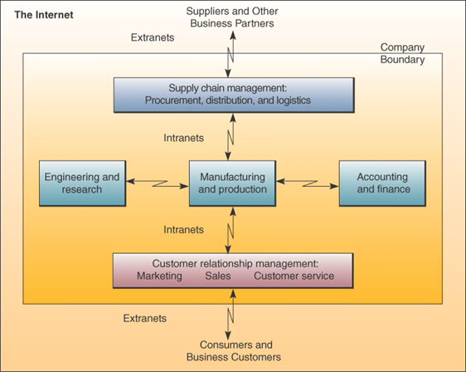
How e-business is being used
Notes:
being/sedang

Slide 19
E-business use
Reengineer/ Rekayasa ulang internal business processes
Enterprise collaboration systems: support communications, coordination and collaboration among teams and work groups, e.g., virtual teams
Electronic commerce: buying, selling, marketing and servicing of products and services over computer networks
Notes:
Electronic commerce: pembelian, penjualan, pemasaran dan pelayanan produk dan jasa melalui jaringan komputer

Slide 20
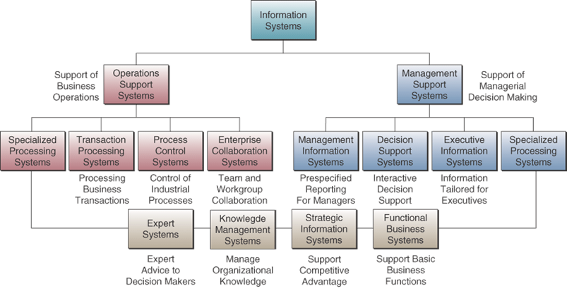
Types of IS

Slide 21
Operations support systems
What are they? (apakah itu)
Efficiently process business transactions
Control industrial processes
Support communications and collaboration
Update corporate databases

Slide 22
Types of Operations Support Systems
Transaction Processing Systems
Record and process (Rekam dan proses ) data from business transactions
Examples: sales processing, inventory systems, accounting systems
Process Control Systems
Monitor and control physical processes
Example: penggunaan sensor kilang minyak bumi to monitor chemical processes
Enterprise Collaboration Systems
Enhance/ Meningkatkan team and work group communications
Examples: e-mail, videoconferencing

Slide 23
Two ways to process transactions
Batch Processing:
Kumpulkan transaksi dari waktu ke waktu dan proses berkala
Example: bank memproses semua cek yang diterima dalam batch pada malam hari
Online Processing:
Process transactions immediately/segra
Example: bank memproses penarikan ATM immediately

Slide 24
Management Support Systems
What are they?
Memberikan informasi dan dukungan untuk pengambilan keputusan yang efektif oleh para manajer

Slide 25
Types of Management Support Systems
Management Information Systems (MIS)
Memberikan laporan dan menampilkan kpd manajer
Example: daily/harian sales analysis reports
Decision Support Systems (DSS)
Memberikan dukungan ad hoc interaktif untuk pengambilan keputusan
Example: A what-if-analysis to determine where to spend/menghabiskan advertising dollars
Executive Information Systems (EIS)
Memberikan informasi penting bagi para eksekutif dan manajer
Example: easy access to actions/tindakan of competitors

Slide 26
Operational or Management Systems
Expert Systems
Provide expert advice (Memberikan saran ahli)
Example: credit application advisor/penasihat
Knowledge Management Systems
Dukungan penciptaan, organisasi dan penyebaran pengetahuan bisnis di seluruh perusahaan (Support creation, organization and dissemination of business knowledge throughout company)
Example: Intranet access to best business practices
Notes:
Support either operations or management applications

Slide 27
Classifications of IS by scope
Functional business systems
Focus on operational and managerial applications of basic business functions
Examples: support accounting, finance or marketing
Strategic information systems
Help get a strategic advantage over its customers
Examples: shipment tracking, e-commerce web systems
Cross-functional information systems
Systems that are combinations of several types of information systems
Provide support for many functions
Notes:
In reality most systems are Cross-functional

Slide 28
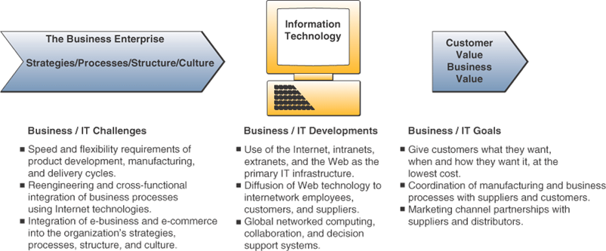
Challenges and Opportunities of IT

Slide 29
Measuring success of an IS
Efficiency
Minimize cost, time and use of information resources
Effectiveness
Support business strategies
Enable business processes
Enhance organizational structure and culture
Increase the customer and business value
What’s the difference between Efficiency and Effectiveness?

Slide 30
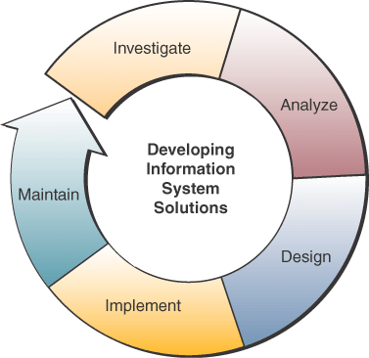
Developing IS Solutions

Slide 31
What is a system?
A system
Seperangkat komponen yang saling terkait
Dengan batas yang jelas
Bekerja bersama untuk mencapai seperangkat tujuan yang sdh ditentukan
By accepting inputs and producing outputs in an organized transformation process
Notes:
Almost everything is a system
One system can be made up of other systems or can be part of a bigger system

Slide 32
Systems have three basic functions:
Input involves capturing and assembling elements that enter the system to be processed
Processing involves transformation process that convert input into output
Output involves transferring elements that have been produced by the transformation process to their ultimate destination

Slide 33
Cybernetic system
All systems have input, processing and output
A cybernetic system, a self-monitoring, self-regulating system, adds feedback and control:
Feedback is data about the performance of a system
Control involves monitoring and evaluating feedback to determine whether a system is moving towards the achievement of its goal

Slide 34
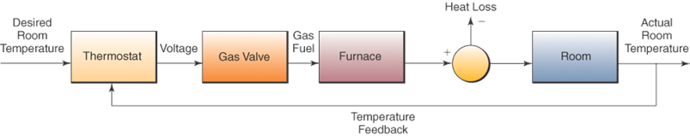
A Cybernetic system
Notes:
A cybernetic system has both feedback and control. A home thermostat accepts the desired room temperature as input and sends a message to fire the furnace. The thermostat provides feedback to shut the system down when the desired temperature is reached.

Slide 35
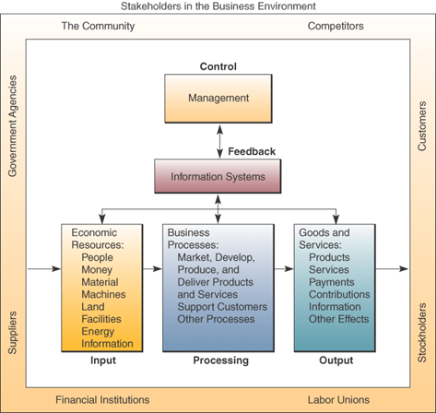
A business as a system
Notes:
A business can be viewed as a system. This system does not operate in a vacuum rather it functions in an environment containing other systems. A business is an open system in that it interacts with other systems in the environment. It is also an adaptive system in that it can change itself or its environment in order to survive.

Slide 36
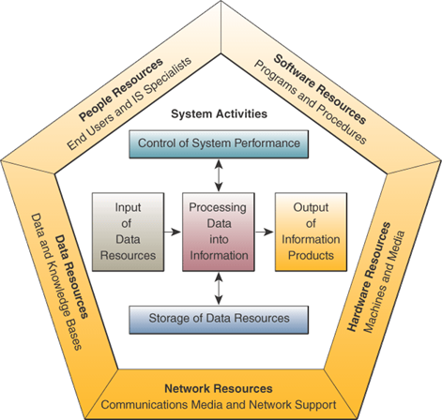
Information systems model
Notes:
Major components of an information: people, hardware, software, data and networks.
These components perform input, processing, output, storage, and control activities.

Slide 37
Components of an IS
People
End users: the people who use the IS or the information from the IS
IS specialists: the people who develop and operate IS
Hardware Resources
All physical devices used in information processing
Machines, data media, peripherals
Software Resources
All information processing instructions including programs and procedures
System software, application software and procedures
Notes:
Hardware:
Peripherals include keyboard, mouse, video screen, printer

Slide 38
Components of an IS (cont.)
Data Resources
Facts about the business transactions
Processed and organized information
Databases of organized data
Network Resources
Communications media
Network infrastructure: hardware and software
The Internet, intranets and extranets
Notes:
Communications media: twisted pair wire, coaxial cable, wireless technologies

Slide 39
Data versus Information
Data are raw facts about physical phenomena or business transactions
Information is data that has been converted into meaningful and useful context for end users
Example:
Sales data is names, quantities and dollar amounts
Sales information is amount of sales by product type, sales territory or salesperson

Slide 40
IS Activities
Input of data resources
Data entry activities
Processing of data into information
E.g., calculate, compare, sort, classify, summarize
Output of information products
Messages, reports, forms and graphic images
Storage of data resources
Data elements and databases
Control of system performance
Monitoring and evaluating feedback

Slide 41
Recognizing IS
As a business professional, you should be able to look at an IS and identify
The people, hardware, software, data and network resources they use
The type of information products they produce
The way they perform input, processing, output, storage and control activities

Slide 42
Case Study Questions
Why do you think that Aviall failed in their implementation of an airplane parts and components inventory control system?
How ahs information technology brought new business success to Aviall? How did IT change Aviall’s business model?
How could other companies use Aviall’s approach to the use of IT to improve their business success? Give several examples.

Slide 43
Aviall Inc. From Failure to Success with IT
Supplier of airplane parts and components
Had lost track of its inventory
Price-tracking software didn’t work with inventory control or purchasing forecasting
Sent wrong parts to wrong customers
Sales falling
Needed a middleware vision: get all the software to work together

Slide 44
Real World Internet Activity
Go to the Aviall’s website at www.aviall.com and look through some of the case studies of business solutions that Aviall provides to its customers.
See if you can find evidence of successes directly related to the new system.

Slide 45
Real World Group Activity
Sometimes, big failures can become big successes when working with innovative applications of technology. In small groups,
Discuss your thoughts as to why it seems a failure has to happen first.
Is it because we don’t hear about the successes unless they come from a failure?
How can we learn from the failures in applying innovative technologies so that more successes can be realized?

Slide 46
Terima Kasih
Good Luck

